Slide 1

DIGITAL MARKETING
project

Slide 2


PROJECT ON :
TATA
MOTORS

Slide 3

PRESENTED BY :
P.N.Arpitha (Team Leader)
Pujari chamundeswari (Team member-1)
R.Bhavani (Team member-2)
R.Rajasekhar Reddy (Team member-3)
S.Asha Sree (Team member-4)

Slide 4
TOPICS ;
Introduction of TATA MOTORS
Brand Study, Competitor Analysis & Buyers/Audiences persona
SEO & Keyword Research
Content ideas And Marketing Strategies
Content Creation And Curation.

Slide 5
Introduction of TATA MOTORS:
World’s today is fast paced ,intermediate,world where people are asking for new answer mobility,Indias leading automotive company TATA Motors is surging ahead with innovative solution.
TATA Motors LTD is India’s largest automotive company.It is the leader in commercial vehicles in each segment ,and among the top three in passenger vehicles with winning products in the compact,midsize car utility vehicle segments.
The company is the world’s fourth largest truck manufacture and the world’s second largest bus manufacture.
TATA Motors has been at the forefront of the Indian automobile industry’s anti-pollution efforts by introducing cleaner engines.Therefore TATA Motors Limited is always commited to understanding customer needs.

Slide 6
History:
TATA group was founded by JAMSHEDJI TATA IN 1945.
TATA Motors is a part of TATA group.
TATA Motors was founded by RATAN TATA.
It tied-up with Daimler-Benz and Entered
Commercial vehicle segment in 1954.
In 1992,it entered Small vehicle segment.
The headquarter of TATA group is in Mumbai.

Slide 7
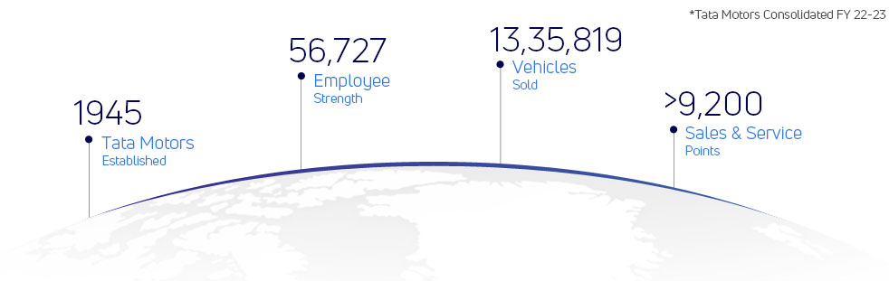
Brand Study of TATA Motors:
Tata Motors Limited, a USD 37 billion organisation, is a leading global automobile manufacturer with a portfolio that covers a wide range of cars, SUVs, buses, trucks, pickups and defence vehicles.

Slide 8
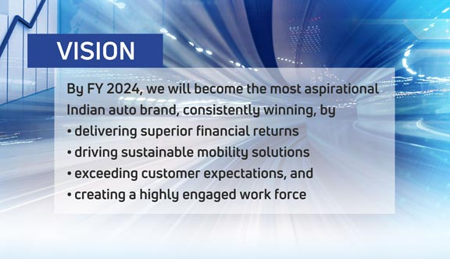

Slide 9
TATA Motors Mission :
Tata Motors Mission To deliver value through our products and services and to be the most trusted global network for our customers and suppliers. To be a responsible value-creation partner for all stakeholders. To innovate mobility solutions with a passion to enhance the quality of life.
USP:
Recognising this trend,TATA Motors took a risk by emphasing safety as a selling point. They recognised that the strength and safety of a vehicle should be the top priority for car buyers . TATA aimed to disrupt the market dominated by maruti by introducing safety as their unique selling proposition

Slide 10
Competitor Analysis of TATA Motors :
1.Maruti Suzuki:
A major player in the indian automotive market,known for its small and mid sized car offerings.
2.Hyundai motor company
HYUNDAI Competes with TATA Motors in various segments,offering a wide range of cars,including compact and mid sized models.
3.MAHINDRA &MAHINDRA
Another prominent indian automaker,known for SUVs and utility vehicles,competing in similar segments.

Slide 11
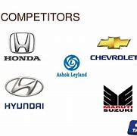
Competitors of TATA Motors:

Slide 12

Buyers/Audiences Persona:
TATA Motors is working hard to change its ‘taxi maker’ brand image.From launching swanky cars to pushing digital marketing.The TATA Group company is going all out to woo the millennials with its four-wheelers.Vivek srivastava,Head of marketing for passenger vehicles business,talks to bussiness line about the brand journey so far and the road ahead
Examples:
1.Budget conscious consumers
2.Commercial Fleet Owners
3.Adventure Enthusiasts
4.Environmentally – Conscious Buyer
5.Urban Commuters
6.Safety-Conscious Parents

Slide 13

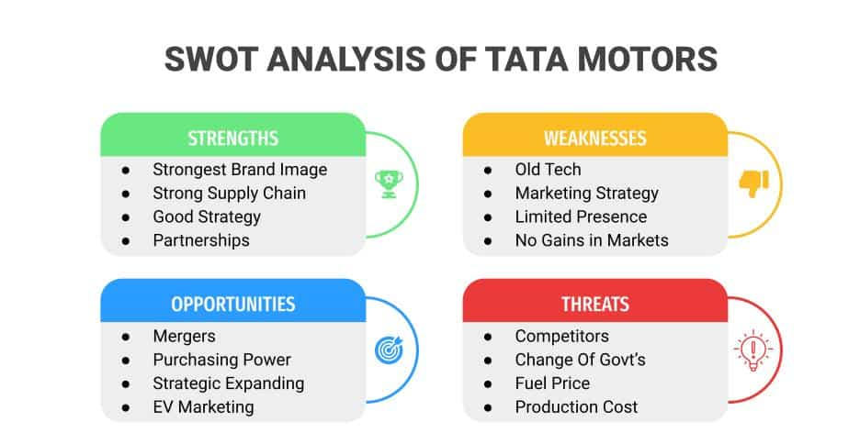
SWOT Analysis:
The Tata Motors SWOT Analysis provides insight into the internal and external factors impacting one of India’s largest and most influential automotive companies. Founded in 1945 as part of the illustrious Tata Group, Tata Motors has etched an indelible mark in the global automotive industry. With a diverse product portfolio encompassing cars, trucks, and electric vehicles, the company has established a strong presence in numerous markets worldwide.

Slide 14
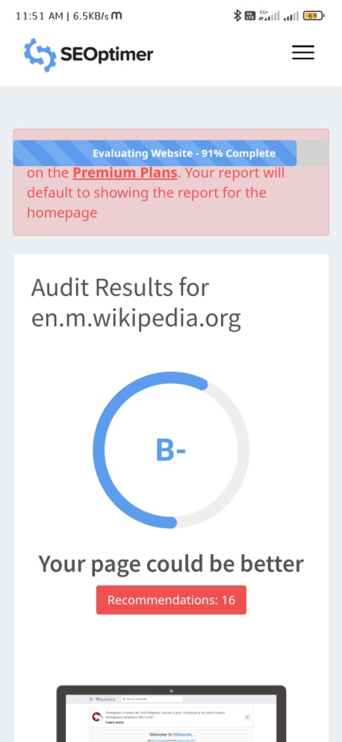
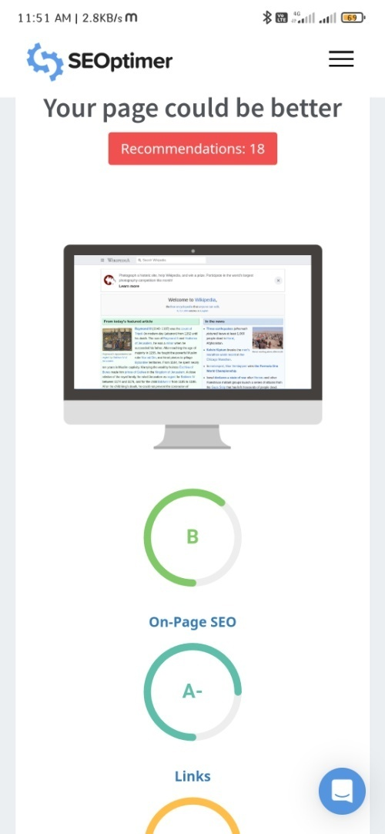
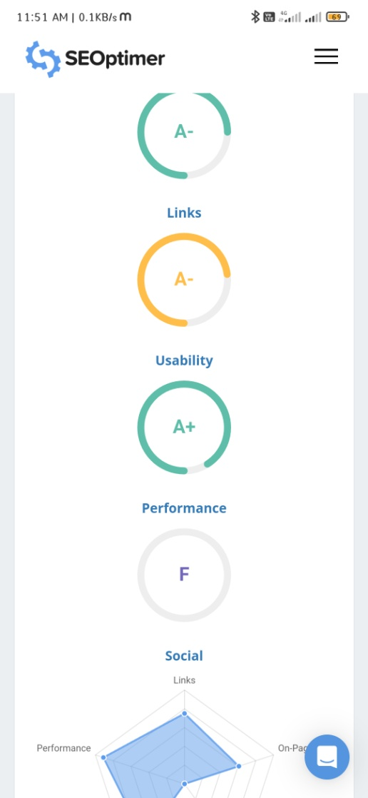
SEO OF TATA Motors :

Slide 15
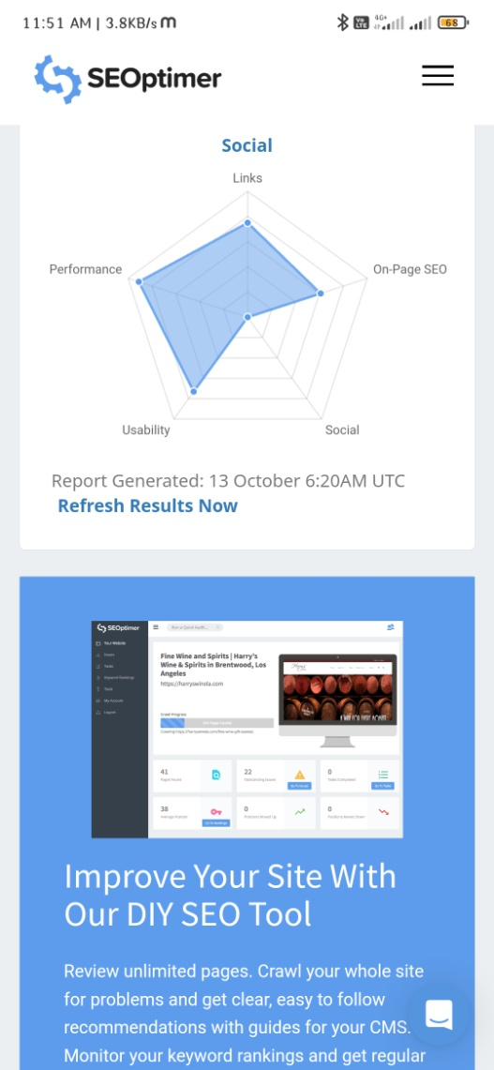
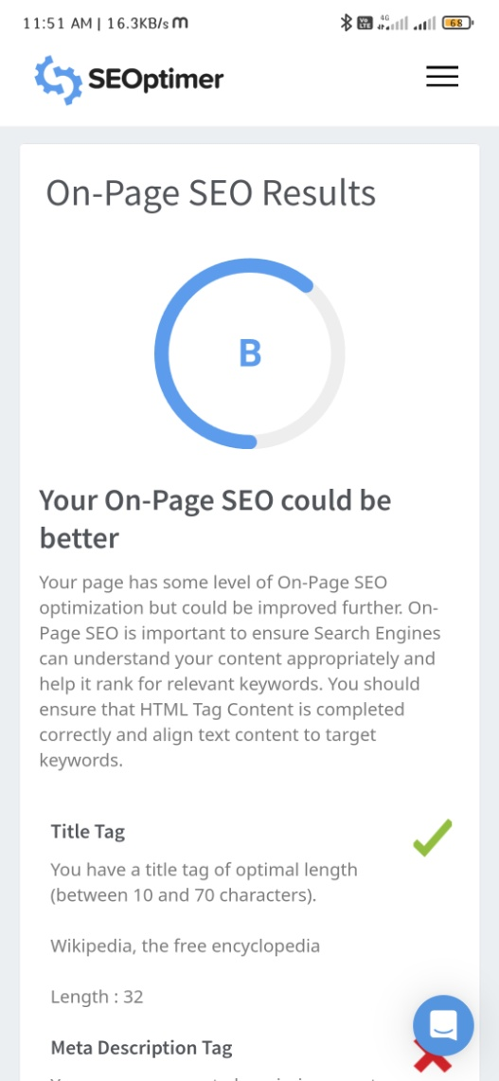
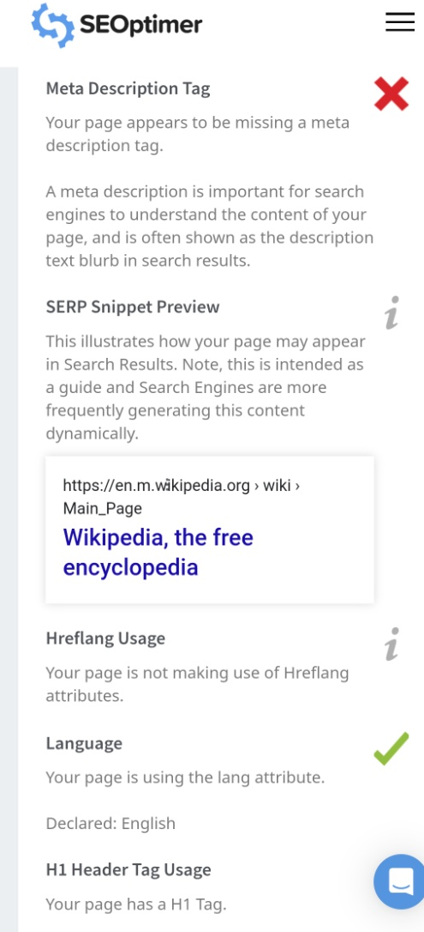

Slide 16
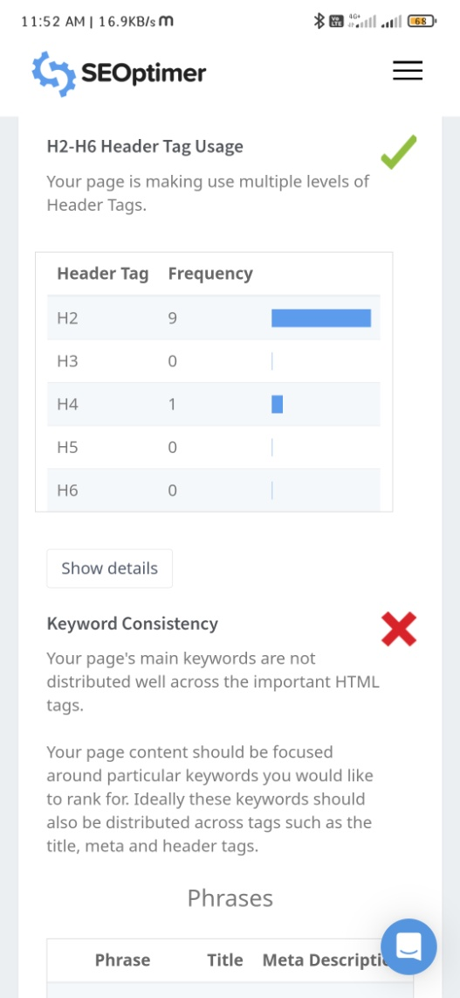
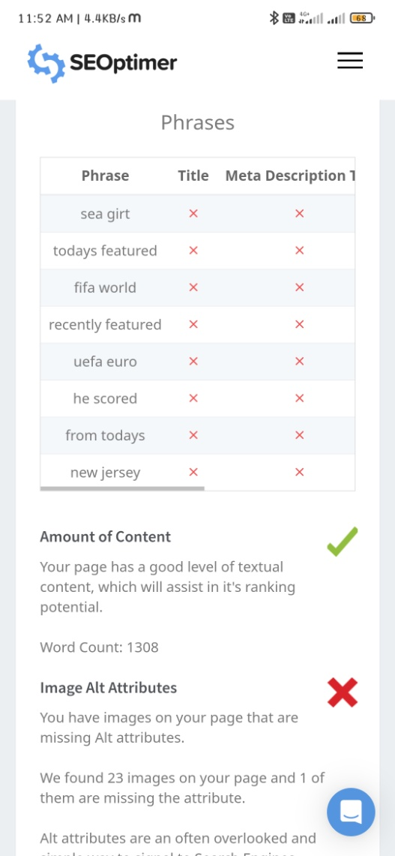
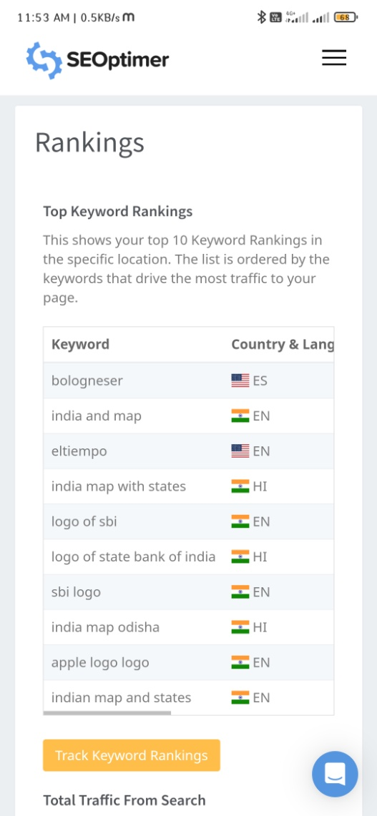

Slide 17
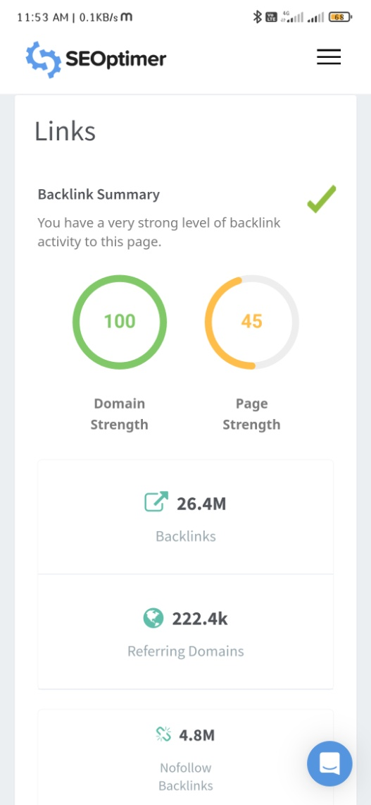
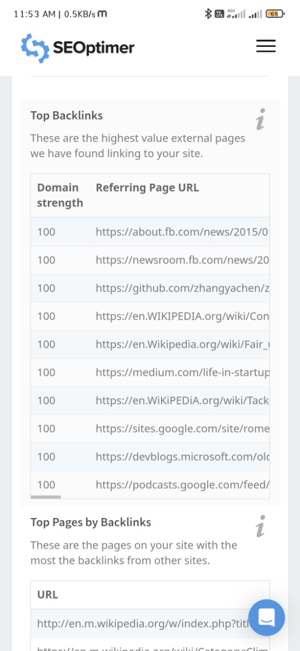
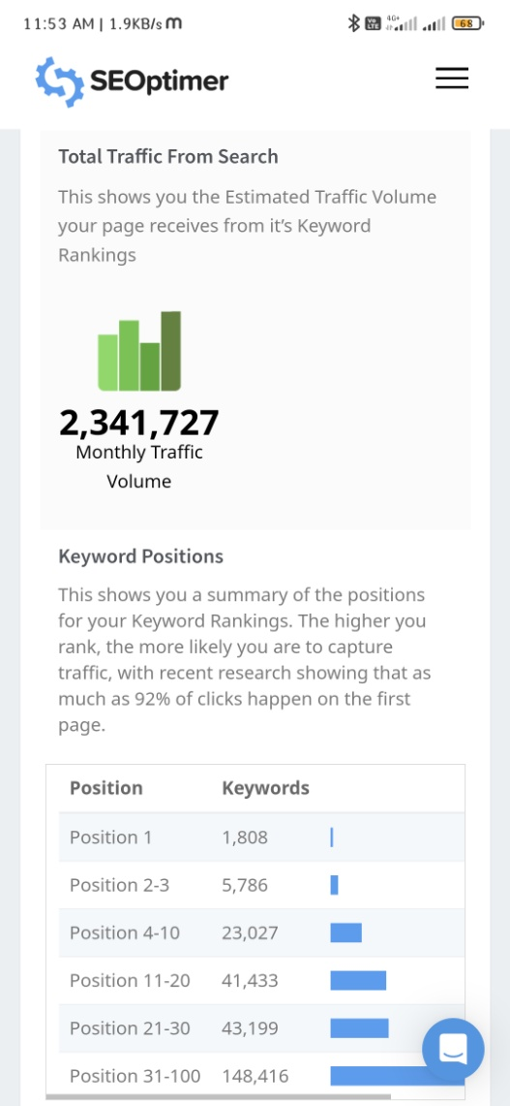

Slide 18
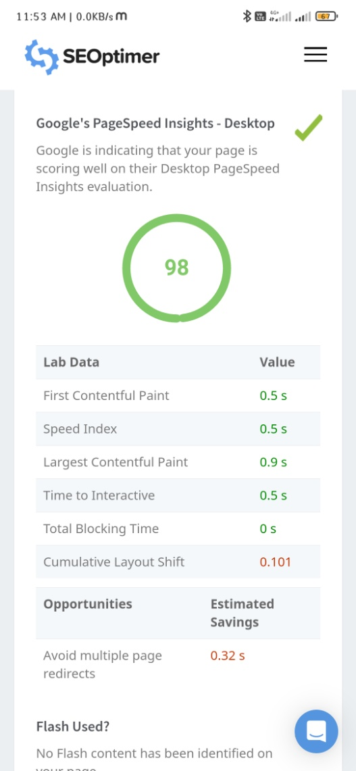
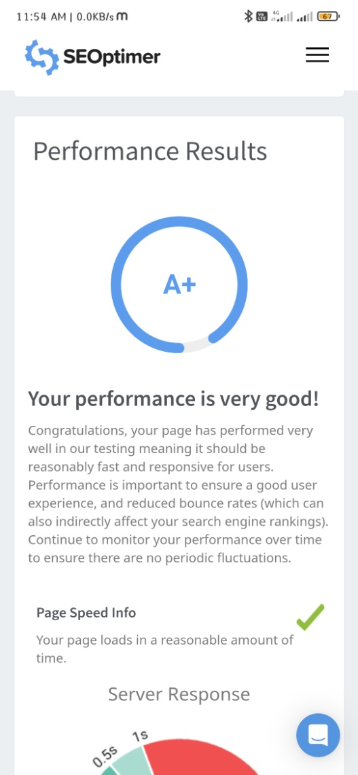
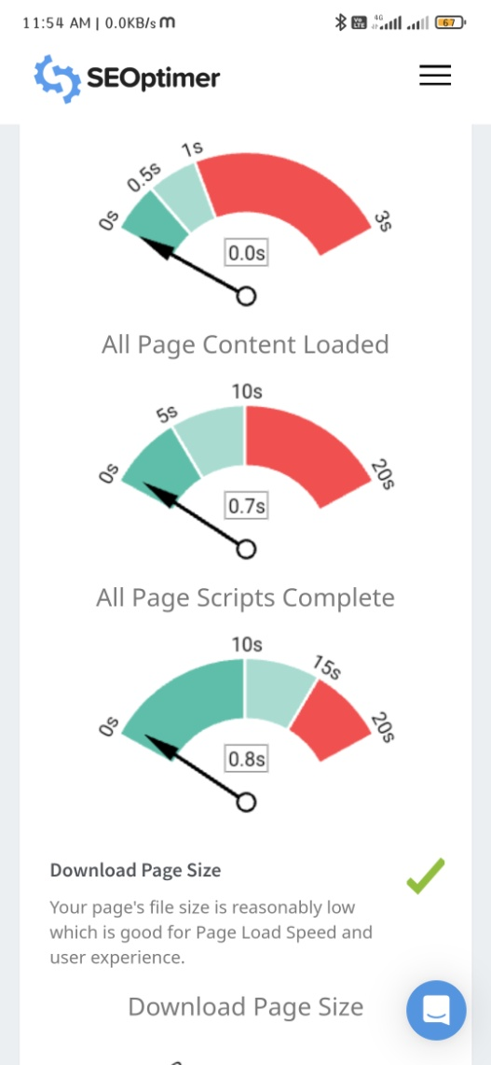

Slide 19
Keyword research for TATA Motors involves identifying relavent terms and phrases that potential customers might use when searching for information related to TATA Motors,it’s products and services.Here are some keywords and phrases that could be relavent .
Keyword Research:
1.TATA Motors
2.TATA Passenger cars
3.TATA Commercial vehicles
4.TATA Electric vehicles
5.TATA Trucks
6.TATA Buses
7.TATA Nano8.TATA Motors financing

Slide 20
Content ideas and Marketing strategies of TATA motors:
Here are some content ideas for TATA Motors.
1.Product Spotlight:
create content that showcases specific TATA motors vehicles,highlighting their features,specifications,and benefits .
2.Customer stories :
Share success stories from TATA Motors satisfied customers who have had positive experience with their vehicles .
3.Comparisions:
Compare TATA Motors vehicles ith competitors in terms of performance ,features and vehicles
4.Road trip ideas:
Suggest exciting road trip destination and itineraries,emphasizing how TATA Motors vehicles can enhance the journey.

Slide 21
Marketing strategies:
Here are some marketing strategies that TATA motors could consider
1.Influencer marketing:
partner with influencers in the automotive industry to review and promote TATA Motors vehicles.Influencers can provide trusted opinions and reach a larger audience.
2.Localized marketing:
Tailor marketing efforts to specific regions and markets .Consider local culture,preferences,and needs to make your messaging more relevant.
3.Product launch events:
Create buzz around ne vehicle launches through events and unveilings.Invite the press ,influencers,and potential customers to build excitement
4.Fleet sales and partnership:
Explore partnerships with businesses and organisations that require fleets of vehicles.offer customised solutions and packages for corporate clients.

Slide 22
5.Customer loyalty programs:
Implement loyalty programs to reward existing customers for their continued support.Discounts,service packages,or exclusive offers can encourage repeat business.
6.Community engagement:
Get involved in the local communities where TATA Motors operates.Sponser events ,participate in social causes ,and show your commitment to the community.
7.Data-Driven marketing:
Utilize data and analytics to understand customer behaviour and preference.This can help in targeting specific segments with personalised offers.
8.International Expansion:
If TATA Motors is targeting global markets,Tailor marketing strategies to suite the local preferences and regulations of each country.
9.Customer Testimonials:
Share real customer stories and testimonials to build trust and credibility.Satisfied customers can be powerful advocates for the brand.

Slide 23
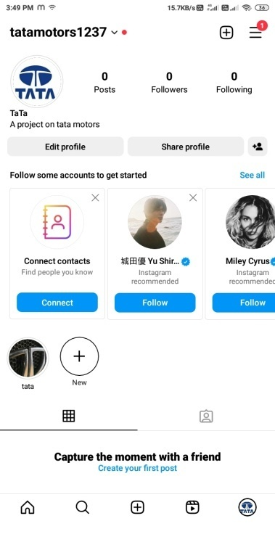
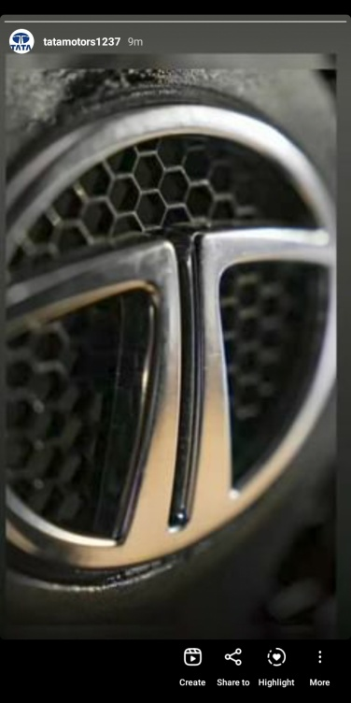
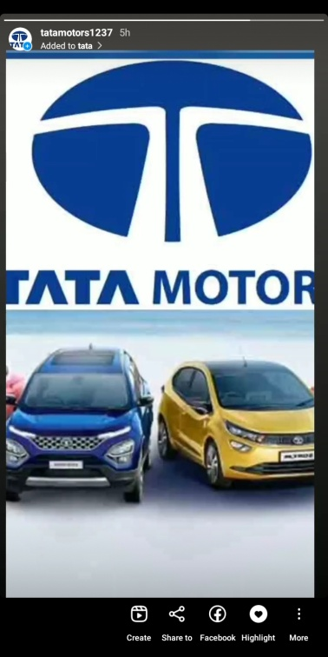
INSTAGRAM Story:
Instagram url:
https://www.instagram.com/?utm_source=pwa_homescreen&__pwa=1
Story url: https://www.instagram.com/stories/tatamotors1237/3212600322489065461/

Slide 24
THANKING YOU…

